Slide 1

Data Deduplication Tool for CSV Files
Department of Data Science
II B.Tech II Semester MiniProject-2024
Submitted by Batch -03
NAME | ROLL NUMBER
K. Purna Vamsi (Team Lead) | 22R21A6787
S. Sai Nath | 22R21A67B9
M. Abhay | 22R21A67A2
GUIDE:
Mrs.Y. Anjali, M.Tech,
Assistant Professor, Department of Data Science.

Slide 2
TABLE OF CONTENTS
01
06
02
03
04
05
INTRODUCTION
Proposed System
07
CODE AND OUTPUT
ABSTRACT
PROBLEM STATEMENT
08
SCOPE
GAP ANALYSIS
09
REQUIREMENTS
OBJECTIVES
10
CONCLUSION

Slide 3
01
INTRODUCTION

Slide 4
INTRODUCTION
Data deduplication is crucial for ensuring data accuracy and efficiency in analysis processes. Our Python-based project focuses on removing duplicate records from CSV files, streamlining data preprocessing and enhancing data quality. By leveraging Python's versatility, users can customize deduplication processes to their specific data needs. This project is vital for data analysts and professionals seeking to optimize storage resources and extract accurate insights from datasets. Through this initiative, we aim to advance data management practices and facilitate informed decision-making.

Slide 5
02
ABSTRACT

Slide 6
ABSTRACT
This project, titled "PyDedupe: Python-based Data Deduplication Tool for CSV Files," addresses the critical need for efficient data deduplication in data management. Duplicate records within datasets can significantly compromise data accuracy, inflate storage costs, and impede data processing. Existing solutions often lack the flexibility and scalability required to handle diverse and large datasets effectively. Our proposed tool leverages Python's capabilities and the CSV module to provide a user-friendly, customizable, and scalable solution for identifying and removing duplicate records based on specified criteria. By enhancing data quality, optimizing storage resources, and streamlining data analysis workflows, PyDedupe aims to support data analysts, researchers, and professionals in achieving more accurate insights and informed decision-making.

Slide 7
03
PROBLEM STATEMENT

Slide 8
PROBLEM STATEMENT
Duplicate records in CSV files hinder data accuracy and analysis efficiency. Existing solutions lack flexibility and scalability for effective data preprocessing. Hence, there's a demand for a user-friendly tool to efficiently identify and remove duplicates from CSV datasets. Customizable deduplication criteria aim to enhance data quality and optimize storage. This tool streamlines data analysis processes, enabling more accurate insights.

Slide 9
04
GAP ANALYSIS

Slide 10
GAP ANALYSIS (Current State and Identified Gaps)
Current State:
Existing Solutions: Various tools and methods for data deduplication.
Challenges: Complex, lack customization, and scalability issues. Require significant manual intervention and technical expertise.
Identified Gaps:
Lack of Flexibility: Insufficient customization options for specific data requirements.
Scalability Issues: Inefficient handling of large datasets.
Complexity and Usability: Advanced technical knowledge needed, inaccessible to non-technical users.

Slide 11
Gap Analysis (Proposed Solution and Expected Impact)
Proposed Solution:
Customization: Specify criteria for deduplication, tailored to diverse data needs.
Scalability: Efficient handling of datasets of all sizes.
User-Friendly Interface: Accessible to users with varying technical expertise.
Expected Impact:
Enhanced Data Quality: Improved data quality by removing redundant entries.
Optimized Storage: Reduction in unnecessary data storage costs.
Improved Analysis Efficiency: Cleaner datasets lead to more efficient and accurate data analysis, better insights, and informed decision-making.

Slide 12
05
OBJECTIVES

Slide 13
OBJECTIVES
Develop a Data Deduplication Tool
Enhance Data Quality
Optimize Storage Resources
Provide Customization Options
Ensure Scalability
Improve Usability
Streamline Data Preprocessing
Support Decision-Making

Slide 14
06
PROPOSED SYSTEM

Slide 15
PROPOSED SYSTEM
The proposed system is a Python-based tool designed to efficiently remove duplicate records from CSV files. It offers a user-friendly interface that allows users to specify criteria for deduplication, such as columns to check and comparison methods. The system utilizes Python's CSV module to read and process input data, implementing a dictionary-based approach to identify and remove duplicates. It provides flexibility and customization options to accommodate various data preprocessing needs. The proposed system aims to streamline the deduplication process, enhance data quality, and improve the efficiency of data analysis tasks.

Slide 16
FLOW DIAGRAM FOR HANDLING DATA

Slide 17
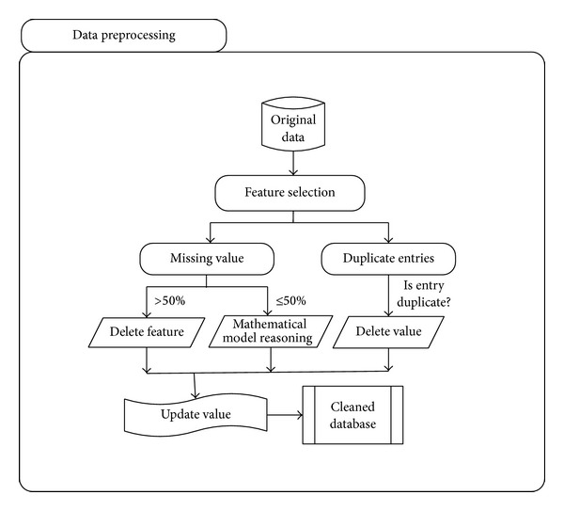

Slide 18
07
CODE & OUTPUTS

Slide 19
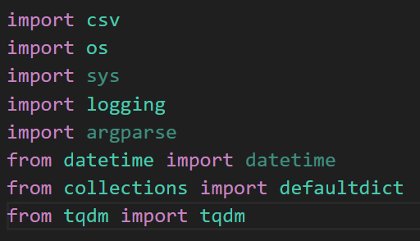
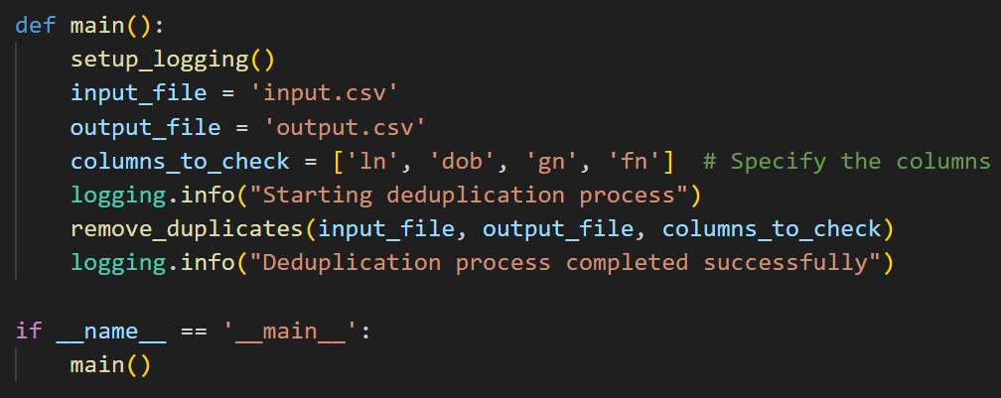
MODULES
MAIN FUNCTION

Slide 20
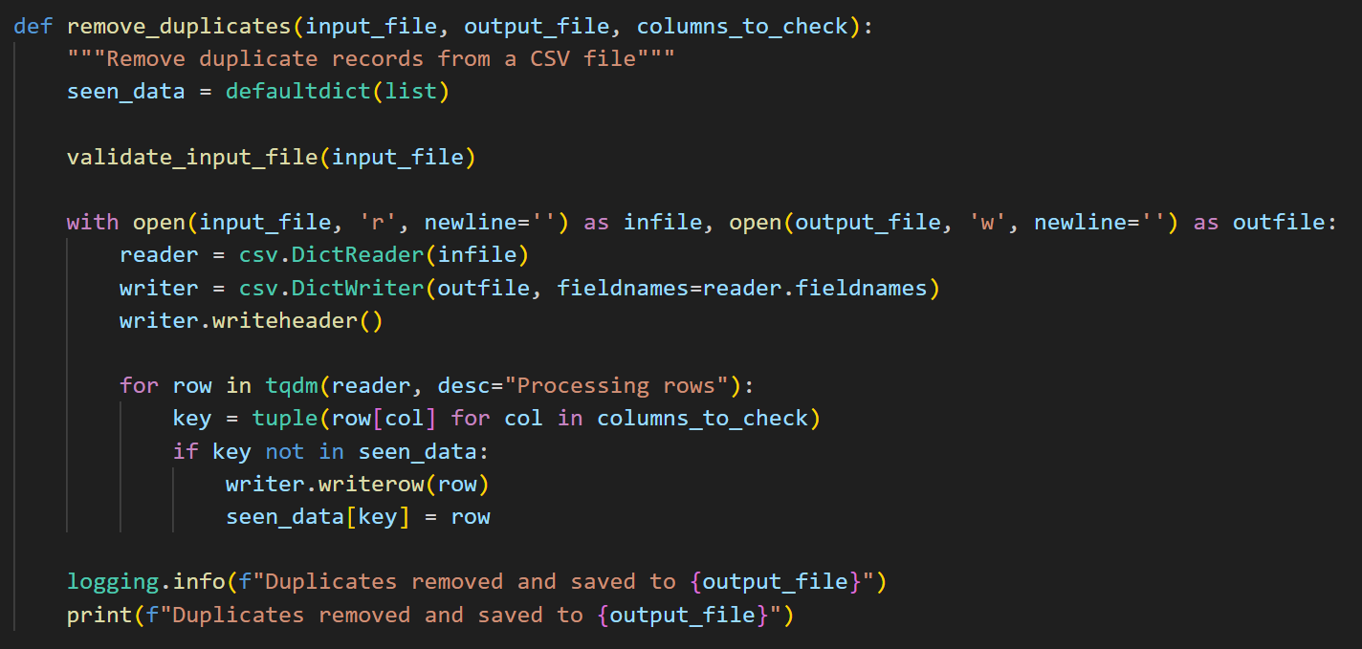
DEFINITION FUNCTION OF THE PROGRAM

Slide 21
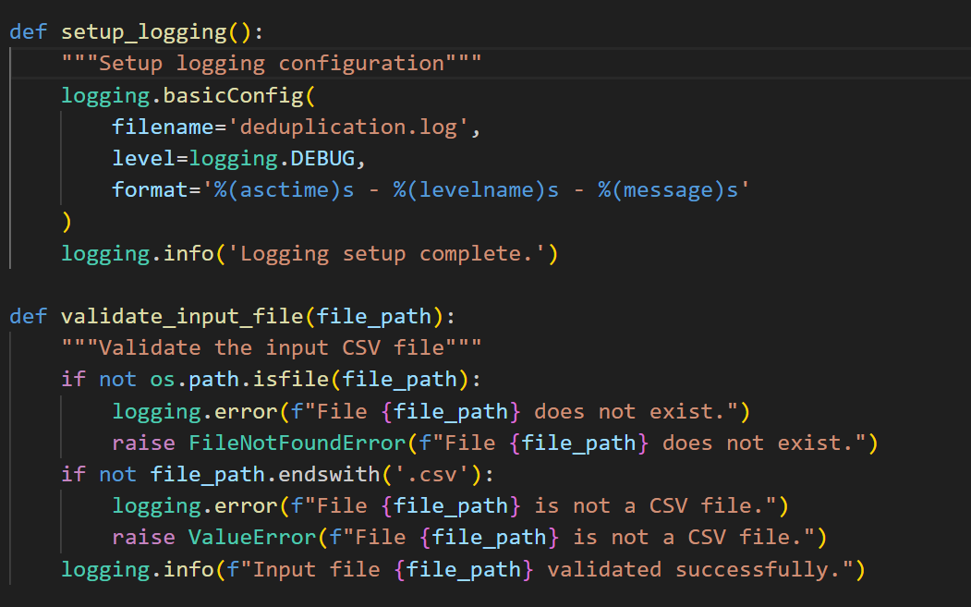
LOGGING IN FUNCTION

Slide 22
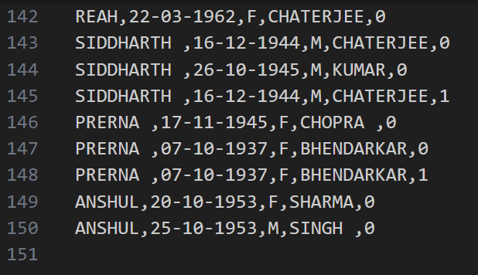
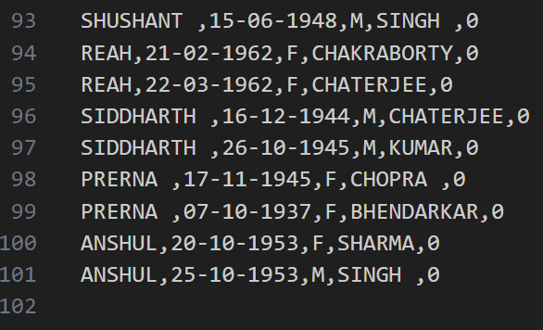
DATASET
OUTPUT.CSV FILE
INPUT.CSV FILE

Slide 23
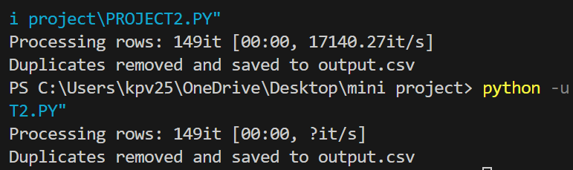
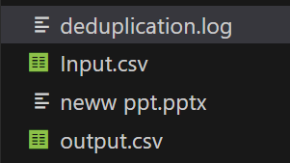
OUTPUT OF THE PROGRAM
FOLDER CONTENTS AFTER EXECUTION

Slide 24
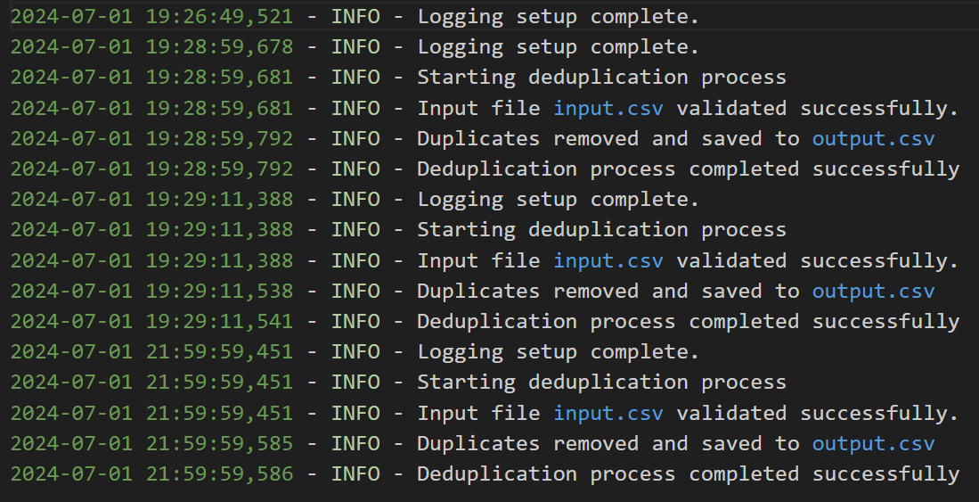
LOGGING IN DETIALS

Slide 25
08
SCOPE

Slide 26
SCOPE
The scope of this project encompasses the development of a Python-based tool designed for efficient data deduplication in CSV files. It aims to provide a customizable solution, allowing users to specify deduplication criteria such as columns to check for duplicates. The tool is designed to handle datasets of varying sizes, ensuring scalability and robust performance. It features a user-friendly interface to cater to users with different levels of technical expertise, thereby enhancing usability. The project also focuses on optimizing storage resources by eliminating redundant data, which in turn improves the efficiency of data analysis processes. Overall, the tool aims to enhance data quality, streamline data preprocessing, and support more accurate and informed decision-making across various domains.

Slide 27
REQUIREMENTS
SOFTWARE REQUIREMENTS | HARDWARE REQUIREMENTS
Python 3.x | Processor
CSV Module | RAM
Development Environment | Storage
Operating System | Display

Slide 28
10
CONCLUSION

Slide 29
CONCLUSION
The completion of the "Advanced Data Deduplication Tool for Efficient Data Management" project marks a significant advancement in the field of data management. This Python-based tool effectively addresses the challenges associated with duplicate records in CSV files, providing a robust, scalable, and user-friendly solution. By leveraging advanced error handling, logging mechanisms, and customizable deduplication criteria, the tool ensures high data quality and efficient storage utilization. The inclusion of a progress tracking feature further enhances user experience, making the deduplication process transparent and manageable. The tool's flexibility to handle datasets of varying sizes and its ease of use across different levels of technical expertise make it an invaluable asset for organizations seeking to streamline their data preprocessing workflows. Overall, this project not only improves data accuracy and reliability but also supports more informed decision-making, driving better insights and outcomes across various domains.

Slide 30
REFERENCES
Christen, P. (2012). Data matching: Concepts and techniques for record linkage, entity resolution, and duplicate detection. Springer Science & Business Media.
Elmagarmid, A. K., Ipeirotis, P. G., & Verykios, V. S. (2017). Duplicate record detection: A survey. IEEE Transactions on Knowledge and Data Engineering, 19(1), 1-16.
Manning, C. D., Raghavan, P., & Schütze, H. (2020). Introduction to information retrieval. Cambridge University Press.

Slide 31

THANK YOU
We appreciate your attention and participation. If you have any questions, please feel free to ask now.

